Slide 1


Welcome!
We’ll start in a few minutes

Slide 2
Introduction
Notes:
These days pose a very uncertain time in the job market
Countries all around the world are under lockdown, businesses have shut down, people are forced to work from home, some people are even losing their jobs...
Despite all the noise. This is a golden time to network if you want to kick start your career, apply to jobs if you’re looking, upskill yourself if you’re looking for a promotion. Yes = you can’t do it physically, and yes, some companies are nto hiring IMMEDIATELY, but you can most definitely do this virtually and be on the recruiter’s radar for when they are going to start hiring.
And we here at Udacity are committed to providing you with adjusted career services to help you (not guarantee it of course)

Slide 3

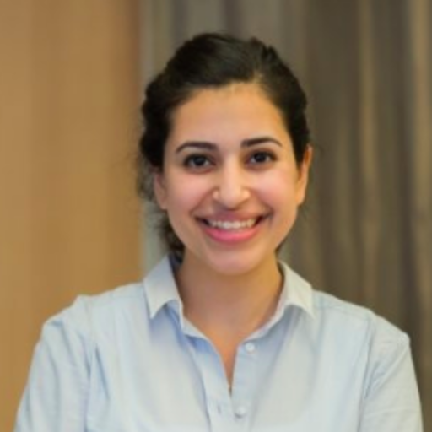

Nada Al Hodairy
Udacity Careers
Muzoon Matar
Udacity Careers

Slide 4




4 types of career services will be offered to all students
1
2
3
4
LinkedIn Review
Github Review
Resume Review
Cover Letter Review
Individualized review by industry professional; receive feedback within 24-48 hrs
Free
Mandatory to graduate
Notes:
There are 4 types of career services
They all entail students submitting their profiles to external reviewers and getting personalized feedback on them within 24-48 hrs
As students you have free and unlimited submissions
You must successfully submit and pass linkedin + github to graduate

Slide 5
When will the Career Services be provided?
Launch of ND
(Week 0)
End of ND
(Week 13-18)
During enrollment
1
Github Review LinkedIn Review Resume Review Cover Letter Review
2
3
4
Your session leads will ask you to complete certain projects in alignment with career sessions (to be detailed next)
Notes:
Github and LinkedIn review will be introduced during the the ND, depending on the syllabus
Additional services for Resume, LinkedIn, Github review, cover letter review are on career portal

Slide 6
Session #1:
ELEVATOR PITCH

Slide 7

1
ELEVATOR PITCH
Description: Session that teaches students how to write an elevator pitch, followed by workshop to draft & present their own pitches
Objective:
(1) Community ice-breaker
(2) Educate students on how to professionally present themselves
Length: 30 mins
Delivered by: SL
Logistics: integrated into Connect session
Logistics: integrated into Connect session
Format: (1) virtual (2) virtual
& physical (depends on session)
Pre-session
During session
Post session
N/A
Break-out session for pilot NDs
Discuss: elevator pitch (10 minutes)
What it is
Why it’s important (presenter or student-led personal anecdote)
Examples (presenter)
Instructions on how to write one (template)
Workshop for students to write and practice their pitch as per template (15 minutes)
5 minutes write
10 minutes practice
Next steps: heads up about next session: Expectations
Pre-shared templates (access here)
Product implications
Links to document: access here

Slide 8
Let’s launch your Job-Search journey!
Notes:
So lets get started with the elevator pitch

Slide 9
Who here likes to network?

Slide 10

Networking is the
WOOOOOORST!
...seriously, it’s the worst.

Slide 11

What is an Elevator Pitch?
One of the most important elements of making a memorable first impression
An elevator pitch is a brief, concise, and timely answer to the question….
“Tell me about yourself”
For discussion: Do you agree? Please share a personal experience!
Notes:
So what is an elevator pitch?
There are so many definitions out there, but the one I like is actually very simple.
An elevator pitch is a brief, concise, and timely answer to the question “Tell me about yourself”
We usually make connections with people in places where we least expect. We also get a short amount of time to communciate with people. What an elevator pitch is helpful for is that it allows you to express yourself effectively, and make a good first impression. This good first impression is what usually leads to a follow-up conversation and a strengthening of your relevant network.
Note - you are still able to network virtually. This is super helpful to type out during a linkedin message or email intro.
I’m now going to ask my two colleagues - Muzoon and Hamad - to present their elevator pitches. I encourage to listen both of them attentively and try to identify what are the commonalities in their pitches.

Slide 12


Elevator Pitch - Example 1
PRESENTER SHOULD PUT PERSONAL PICTURE
Hello! My name is Felipe.
I currently work at Udacity as the Session Lead for the Data Fundamentals Nanodegree that they are running in Chile. I am a scientist by profession (Biotechnology engineer) with more than 8 years experience in R&D.
In my work I usually interpret trends or patterns present in complex data sets. As I realised that I had the strong analytical skills needed to work with all kind of Data, I immersed myself into the data world by helping enterprises to collect, organize, analyse, and disseminate significant amounts of information allowing them to take data driven decisions.
Tell me about you, what do you do?
….
Felipe A. Millacura
Notes:
Hamad!

Slide 13
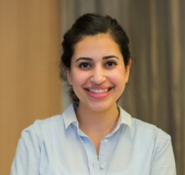
Elevator Pitch - Example 2
Hi! My name is Muzoon.
I work at Udacity, a US based education start-up. I focus on developing and launching career services for tech graduates in fields of data science, web development. This includes resume reviews, career fairs, and job-interview matching.
Prior to Udacity, I was a Business Analyst at McKinsey & Company, where I analyzed data for companies to increase their profitability.
I’m currently looking for a role that can combine my passion for the education technology space and my skill in data analysis.
What about you?
Muzoon Mattar
Muzoon Matar
Notes:
First example

Slide 14
Elevator Pitch - Example 2
Hi! My name is Hamad.
I have been working at Udacity as a Partnerships Manager for the last year. Prior to that, I was a web course manager. I have a software engineering background from King Fahad University of Petroleum & Minerals.
I also co-founded a software development startup. We developed software and advised >20 startups.
I’m interested in meeting people who are developing the tech entrepreneurial ecosystem in Saudi, both from a software and talent perspective.
What are you working on?
Hamad Almuqbel
Muzoon Matar
Notes:
Hamad!

Slide 15
Elevator Pitch - Examples
Muzoon Mattar
Hamad AlMuqbel
Hi! My name is Muzoon.
I work at Udacity, a US based education start-up, as a Careers Associate. I focus on developing and launching career services for tech graduates in fields of data science, web development. This includes resume reviews, career fairs, and job-interview matching.
Prior to Udacity, I was a Business Analyst at McKinsey & Company, where I analyzed data for companies to increase their profitability.
I’m currently looking for a role that can combine my passion for the education technology space and my skill in data analysis.
What about you?
Hi! My name is Hamad.
I have been working at Udacity as a Partnerships Manager for the last year. Prior to that, I was a web course manager. I have a software engineering background from King Fahad University of Petroleum & Minerals.
I also co-founded a software development startup. We developed software and advised >20 startups.
I’m interested in meeting people who are developing the tech entrepreneurial ecosystem in Saudi, both from a software and talent perspective.
What are you working on?
Notes:
What are some commonalities in Muzoon and Hamad’s elevator pitch? Any volunteers?

Slide 16
Elevator Pitch - Examples
Muzoon Mattar
Hamad AlMuqbel
Hi! My name is Muzoon.
I work at Udacity, a US based education start-up, as a Careers Associate. I focus on developing and launching career services for tech graduates in fields of data science, web development. This includes resume reviews, career fairs, and job-interview matching.
Prior to Udacity, I was a Business Analyst at McKinsey & Company, where I analyzed data for companies to increase their profitability.
I’m currently looking for a role that can combine my passion for the education technology space and my skill in data analysis.
What about you?
Hi! My name is Hamad.
I have been working at Udacity as a Partnerships Manager for the last year. Prior to that, I was a web course manager. I have a software engineering background from King Fahad University of Petroleum & Minerals.
I also co-founded a software development startup. We developed software and advised >20 startups.
I’m interested in meeting people who are developing the tech entrepreneurial ecosystem in Saudi, both from a software and talent perspective.
What are you working on?
Notes:
What are some commonalities in Muzoon and Hamad’s elevator pitch? Any volunteers?

Slide 17
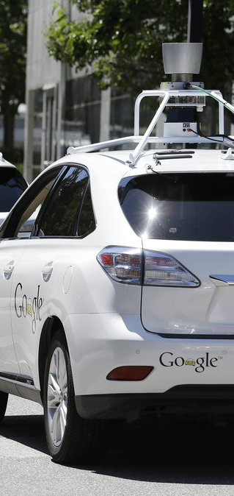
Elevator pitch
Your name & what you do
Brief of your background (education, job)
Clearly state what type of role you are looking for
Elaborate on your experience the field
Explain why you are interested in the field
Share soft skills relevant to the role you are interested in (e.g. communication, collaboration)
Share any relevant additional education (if relevant)
Articulate your strongest (recent) project (if relevant)
If you touch on buzzwords, without pretending to know more than you do
Ask them about themselves
CRITICAL: 20-60 SECOND MAX; AN ELEVATOR SPEECH IN AN INTERVIEW CAN GO UP TO 2 MINUTES
Notes:
Exacatly - all that is correct.
What you see in front of you are common elements in an elevator pitch. You would usually include: DESCRIBE ALL ELEMENTS

Slide 18

ELEVATOR PITCH - WRITE IT DOWN!
Instructions
Example
Complete the forms in front of you;
Who am I? (i.e. name)
What is my background? (i.e. field of study, work, most recent project)
What am I looking to do? (i.e. what do you you want to do & why?)
Close out the conversation (i.e. ask them questions, schedule follow up touch point)
Hi! My name is Muzoon.
I work at Udacity, as a Careers Associate. I focus on developing and launching career services for tech graduates.
Prior to Udacity, I was a Business Analyst at McKinsey & Company, where I analyzed data for companies to increase their profitability.
I’m currently looking for a role that can combine my passion for the education technology space and my skill in data analysis.
What about you?
Notes:
So now its time to practice your 45 second elevator pitch. And to ensure it is 45 seconds, we would like to make sure you follow a structure similar to the one you see in front of you.
FOR VIRTUAL SESSION: please share with them template via slack
FOR PHYSICAL SESSION: please print out template before hand and distribute it during the session

Slide 19
ELEVATOR PITCH - LET’S PRACTICE 5 TIMES!
Instructions
Reformulate in 2 lines facing each other; each line should have same # of people
You will have the chance to repeat your elevator pitch 5 times to 5 different people (assuming a full house)
You will be seated / standing in front of any given individual for 2 minutes, where both of you share your pitches (1 minute each)
After 2 minutes, you will move anti-clockwise
If you are not done with your pitches by the time we call the 2 minute mark, you will have to stop & move to next round
Notes:
Great - so how did that feel?
If I can leave you with one takeaway here, it is that your pitch will constantly evolve. So always think about it, practice it, and change it depending on the setting and context.
NOTES FOR ALL SLs:
Ensure that students don’t give feedback to each other then and there and to leave their feedback till the end to share with everyone in their session
Leave 2 minutes in the end to collect general learnings from the students about their experience
NOTES FOR VIRTUAL SESSIONS SL:
Please use breakout rooms to create groups. For the anti-clockwise effect, we can achieve it by shuffling the students randomly across different breakout rooms. We can discuss further during the call.
NOTES FOR PHYSICAL SESSIONS SL:
Help the students reformulate in 2 lines and conduct this

Slide 20

© 2018, Udacity. All rights reserved.

